Slide 1
Downloading and Installing SQLExpress

Slide 2
Process
Forecast 5 is shipped with SQL Local Database. We recommend that the user upgrades this to SQLExpress to obtain the faster access and enhanced memory features of SQLEXpress.
The process is:
Download and install SQL Express 2017;
Download and install SQL Server Management Studio – SSMS- identifying the “Instance” of SQLExpress installed in 1. above, (Instance is a fancy word for name!);
Using SQLServer Configuration Manager, ensure that all “pipes” and “TCP/IP” are enabled and running for the Instance;
In Forecast 5, change the version of SQL Server to align with the Instance of SQLExpress set up when installing SQLEXpress (which was subsequently “connected” with SSMS) and create a new database
The slides that follow demonstrate how this is done.

Slide 3
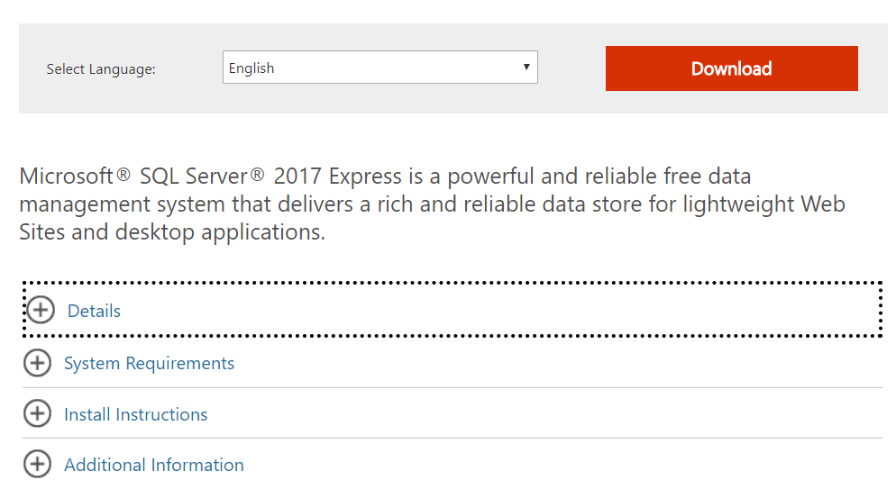
Downloading SQL Express
SQL EXpress 2017 download link

Slide 4
Choose Basic installation

Slide 5
Hit install

Slide 6
A series of windows will be offered; go next

Slide 7
Install rules – warning about Firewalls

Slide 8
Firewalls and SQL Server
Its unlikely that this will be an issue on installation, but this link is inserted here in case…..
MS article re Firewalls

Slide 9
Installation type

Slide 10
Accept the licence terms

Slide 11
Feature selection

Slide 12
Choose the Default “Instance” name

Slide 13
Server configuration

Slide 14
Database configuration and authentication mode

Slide 15
Installation Complete

Slide 16
Once SQLExpress installation is complete, next step is - Install SQLServer Management Studio (SSMS)

Slide 17
Choose current version v17.3

Slide 18
Look for the download button; this file is just short of a gigabyte in size.

Slide 19
Install SSMS

Slide 20
When installed, Open SSMS

Slide 21
In SSMS, hit Connect

Slide 22
Browse to find and “connect” to the Instance of SQLExpress setup

Slide 23
Load SQL Server Configuration Manager from this link Paste the relevant text into the Windows Start (Search) window

Slide 24
Enable Pipes and TCP/IP

Slide 25
In Forecast 5, hit Change SQL Server

Slide 26
Changing the SQL Server and database names in Forecast 5

Slide 27
SQLExpress should now be installed!

